Slide 1
Overview
The RoboBrailleWebAPI is a server side solution for managing accessible document conversions. It has been developed and refined over the years to work with more diverse use cases.
HTTP-based RESTful API
Programmed in C#
Is an ASP.NET Web API 2 project
Uses a Microsoft SQL Server database
It provides a framework for accessible document conversions, therefore it must be purposely tailored to fit your individual needs.

Slide 2
RoboBraille Solution Architecture
Requests encoded as Multipart/form-data (input parameters and file)
Uses APIControllers to handle the request (BrailleController, AudioController)
Requests get processed according to the conversion type
Example: Text to Braille, Image to Text, Text to Audio
Stores each request as a Jobs (BrailleJob, AudioJob, DaisyJob)
Requests can be chanined to accomplish more complex conversions
Example: Image to Audio: Image to Text + Text to Audio
Each job is processed in it’s own Repository (BrailleJobRepository)
Repositories handle conversions or delegate the task to other dll’s
Job results are stored in the database

Slide 3
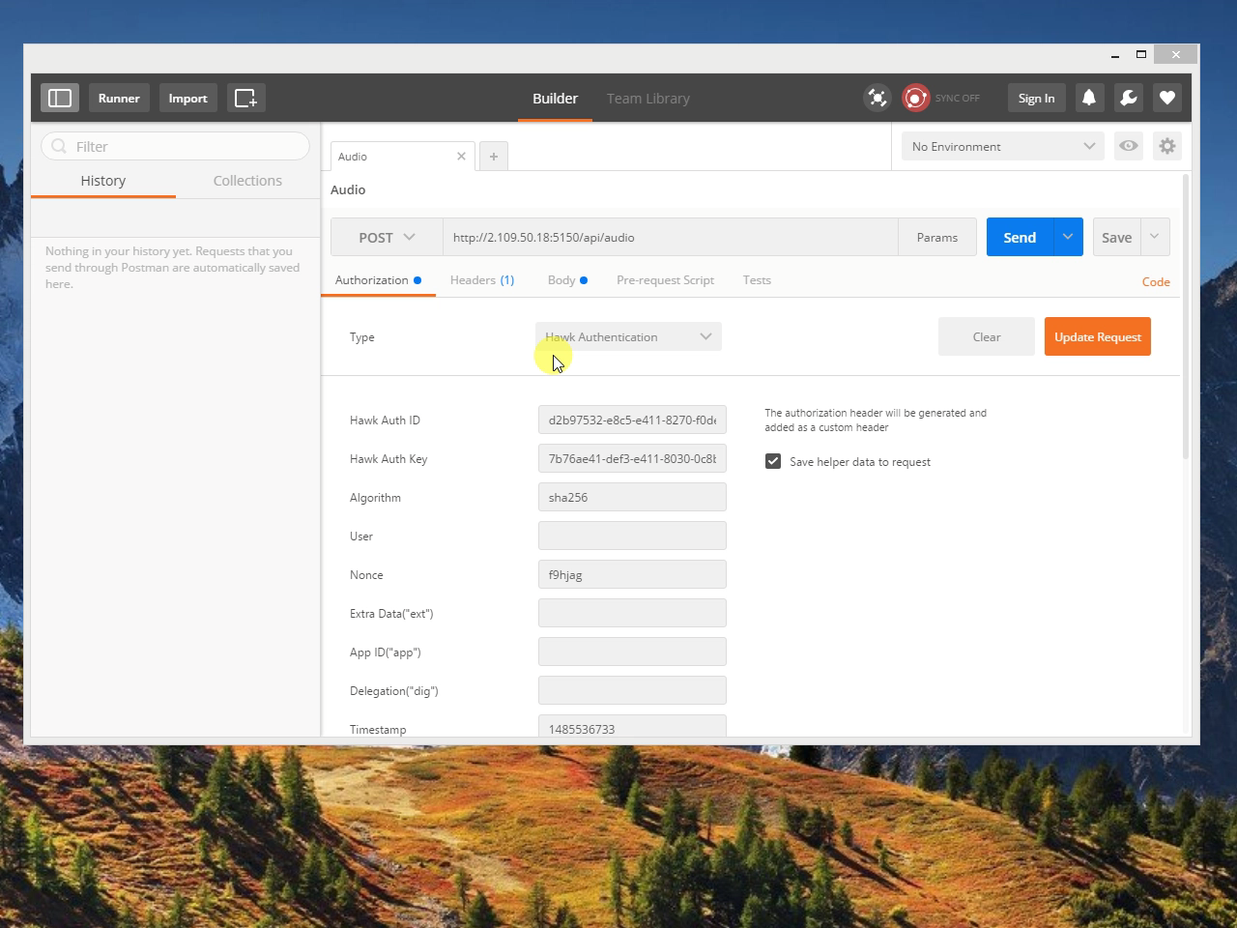

Slide 4
Other features
Integration with Amara to retrieve subtitles from videos (based only on URL’s from video streaming websites - YouTube, Vimeo)
A Document Structure Recognition stub without the conversion library
A Language To Language Translation stub that can integrate with RESTful APIs such as Google Translate API
A demo client application at www.example.org/RoboBrailleSPA (not a complete implementation)
Token based authentication using Hawk
A demo user management page (not a complete implementation)

